Slide 1

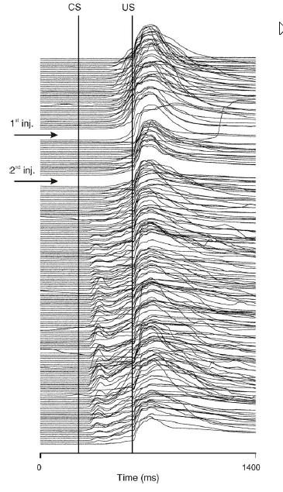
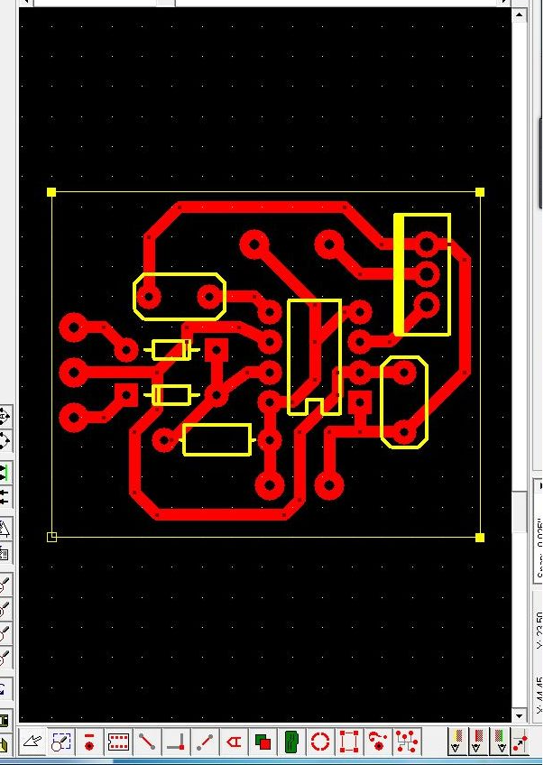
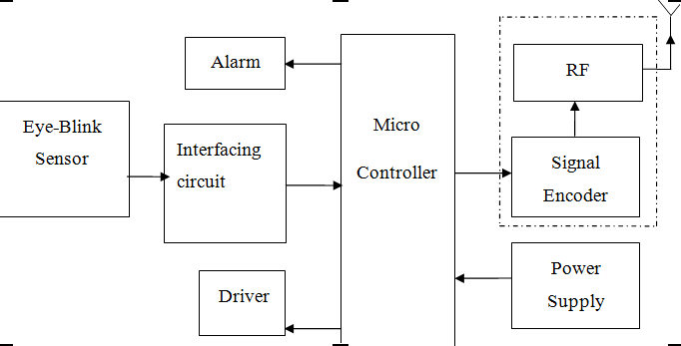
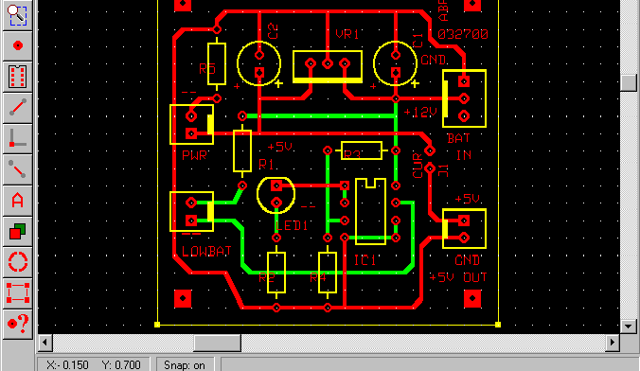
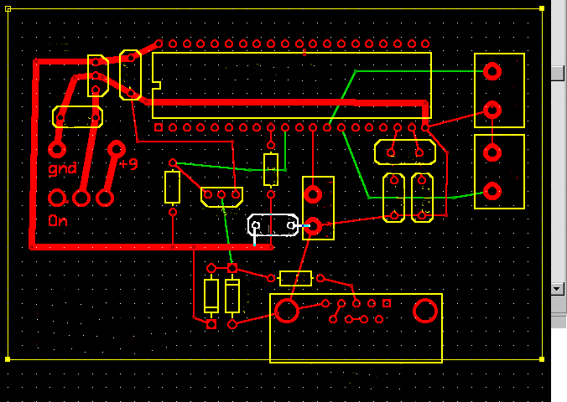
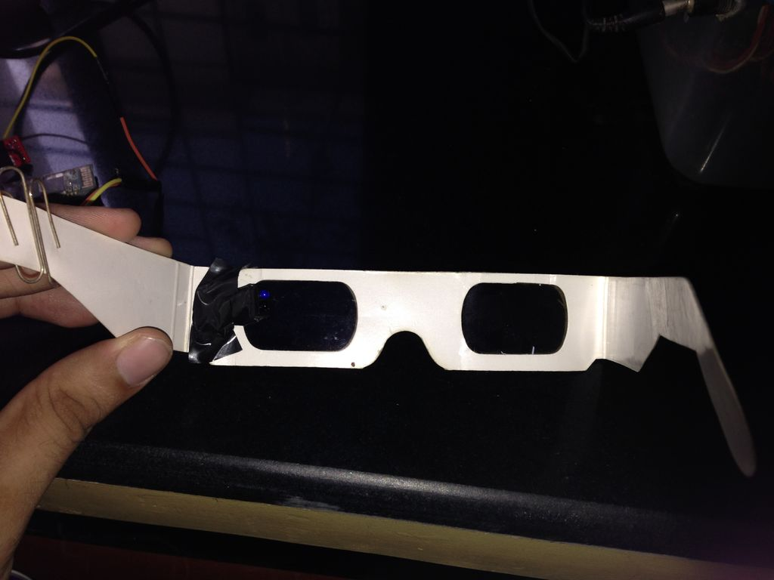
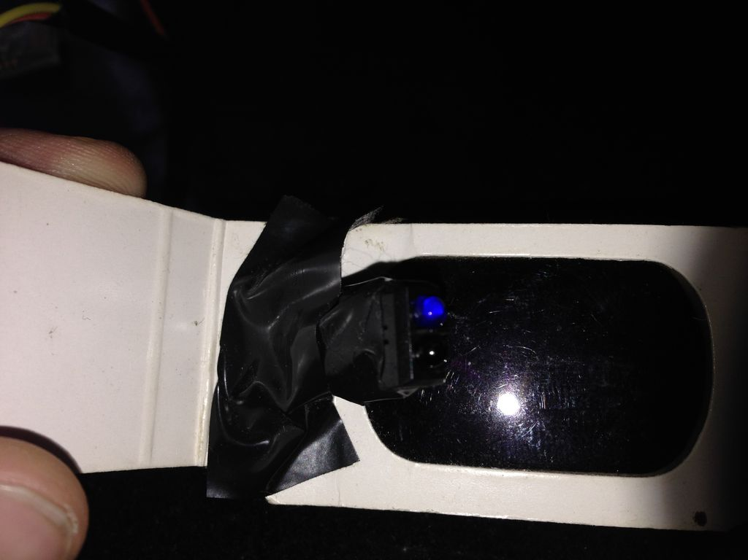
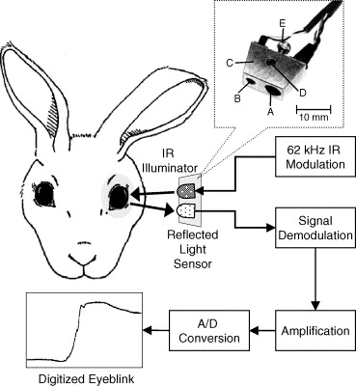
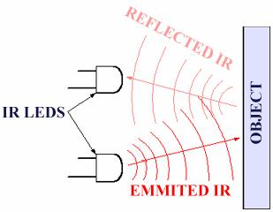
INSERT
LOGO HERE
INSERT
LOGO HERE
DROWSINESS DETECTION SYSTEM
AN ACCIDENT PREVENTION SYSTEM FOR VEHICLES
Name: R.Sravya Tanmayee
Roll No:edm13b025
IIITDM-Kancheepuram.
Guided by :
Dr. M.D.Selvaraj
Signature:
INTRODUCTION
SENSING TECHNIQUE
METHODOLOGY
Now a days accidents are increasing at a large pace, and various technologies are being introduced to reduce the accidents. This project provides a means of accident prevention using eye blink sensor wherein the vehicle is stopped immediately and intimated wherever needed. This project uses eye blink sensor, which is placed near the eye to sense the blink count and this information is transmitted in the form of pulses and is given to the Microcontroller. The Microcontroller uses this information to compare with the normal eye blink programmed in the chip and if any abnormal situation arises the vehicle is stopped with an alarm indication.
Digitalized eye blink:
The regular eye blink of a human eye gives a graph like the figure below.
This is taken as a reference and is repeatedly compared to the real time data being received by the receiver and is compared with a comparator..
The comparator in the circuit diagram checks for abnormalities .
The system works when the driver closes the eyes for around 3 seconds. There is an Infra-red sensor in the system, it senses the eye blink of the driver and when the eye is closed for 3 seconds, the system gives an alarm and also there is a vibrator present at the back of the seat, the vibrator vibrates and the break is also applied gradually. This is how the project works
The transformer in the system is 230 V and it converts power to 12V as all the parts in the system needs only 6V to 12V . It is connected to the Microcontroller, Timer circuit, buzzer and the alarm. When the system is on the circuit works and the wheel rotates as the relay circuit is closed .When the driver closes his eyes for around 3 seconds, the IR sensor gives information to the timer circuit it activates the Microcontroller and the microcontroller gives information to the three relays and the relays gets open and the wheel gets stopped, the break is applied and also the vibrator will vibrate and the alarm will be ringing. In the circuit there are capacitor, Resistance, diode and also regulator to control and purify the current flow. Capacitors and regulator are mainly fixed for adequate current flow to the components.
OVERVIEW
Various studies have suggested that around 20% of all road accidents are fatigue-related, up to 50% on certain roads.
When people drive while they are tired, drowsy or sleepy, this is commonly referred to as “driver fatigue "or drowsy driving.
In order to prevent these devastating accidents, the state of drowsiness of the driver should be monitored.
Figure 2:Digitalised eye blink
FOOTPRINTS OF MODULES
TRANSMITTER MODULE
DROWSINESS DETECTION TECHNIQUES
The below are the most commonly used techniques to check the drowsy state of a person. Every method has certain advantages and disadvantages as listed in the table.
Figure5:foot prints of various modules
s.no | Measures | Parameters | Advantages | Limitations
1. | Subjective | Questionnaire | Subjective | Not possible in real time
2. | Vehicle Based | Deviation from the lane position Wheel movement | Nonintrusive | Unreliable
3. | Physiological | Energy features derived from ECG, EEG | Reliable Accurate | Intrusive
4. | Behavioral | Yawning Eye blink Head pose | Nonintrusive Ease of use | Lighting conditions
PROTOTYPE
Figure3: transmitter module
IR MODULE
Infrared transmitter is one type of LED which emits infrared rays generally called as IR Transmitter. Similarly IR Receiver is used to receive the IR rays transmitted by the IR transmitter.
The transmitted signal is given to IR transmitter whenever the signal is high, the IR transmitter LED is conducting it passes the IR rays to the receiver. The IR receiver is connected with comparator. In the comparator circuit the reference voltage is given to inverting input terminal. The non inverting input terminal is connected IR receiver. When interrupt the IR rays between the IR transmitter and receiver, the IR receiver is not conducting. So the comparator non inverting input terminal voltage is higher than the inverting input. Now the comparator output is in the range of +5V. This voltage is given to microcontroller so led will glow.
When IR transmitter passes the rays to receiver, the IR receiver is conducting due to that non inverting input voltage is lower than inverting input. Now the comparator output is GND so the output is given to microcontroller.
WORK DONE
WORK DONE | WORK TO BE DONE
1.Study of various methods for detecting the drowsiness of a person and optimising on the most feasible technique. | 1.PCB printing (chemical process)
2.Study of the modules required for the drowsiness detection system using eye blink IR sensor. | 2. Integrating the modules and evaluating performance
3. PCB designing and generating footprints for the working circuits. | 3. Checking for improving efficiency.
4..Cost analysis and purchasing the components. | 4.Making it compact and reporting
Table1:Drowsiness detection techniques
A
B
SENSING TECHNIQUE
From the previous table we can understand why eye blink detection method is used:
The sensor consists of an IR-LED/Photodiode pair
mounted on a pair of glasses.
The value returned by photodiode varies depending on
whether the IR light is reflected off the eyelid or the
white sclera of the eye.
This is used to obtain threshold values for the blink detection.
LIMITATIONS
Faulty operations
  the driver is wearing glasses
  the driver’s IR-reflecting objects such as earring
Drowsiness usually happen during the evening/night hours
  Light poles might be recognized as eye candidates due to the shape and size on screen.
Figure4: IR Sensing module
REFERENCES
ALARM MODULE
[1] Robert D. Ogilvie and John R. Harsh, Sleep Onset. New York:
American Psychological Association, 1994.
[2] Mitsuaki Yamamoto, Night—day—night Sleep—Wakefulness Monitoring
by Ambulatory Integrated Circuit Memories. Boston: Psychiatry and
Clinical Neurosciences, 1999.
[3] Singh, Sarbjit and Papanikolopoulos, N.P. “Monitoring Driver Fatigue
Using Facial Analysis Techniques”, IEEE Intelligent Transport System
Proceedings pp314-318, 1999.
[4] Perez, Claudio A. et al. “Face and Eye Tracking Algorithm Based on
Digital Image Processing”, IEEE System, Man and Cybernetics 2001
Conference,pp 1178-1188, vol.2 (2007)
[5] F. D. Torre, C. J.G. Rubio, E. Martinez, “Subspace Eye Tracking for Driver
Warning,” in Proceedings of the IEEE, Vol. 8, No. 3, 2008, pp 329-332.
EMITTED IR
A buzzer or beeper is a signalling device, usually electronic, typically used in the alarm modules. It most commonly consists of a number sensors connected to a control unit that determines the conditions for when the trigger has to go on., The output is given by usually illuminating a light , and sounding a warning in the form of a continuous or intermittent buzzing or beeping sound.
Figure 1:IR sensor working
The transmitted signal is given to IR transmitter whenever the signal is high, the IR transmitter LED is conducting it passes the IR rays to the receiver.
This data is given to the comparator to compare and execute the further functions.

